Slide 1
Applied Economic Analysis for Justice Reinvestment in Australia
35th Annual ANZSOC Conference
Held in Melbourne on 06-08 Dec 2023
Cameron Russell, PhD Program, Deakin University

Slide 2
Supervisors
Dr Clare Farmer, Associate Professor (Criminology), Deakin University
Dr Romain Gauriot, Senior Lecturer (Economics), Deakin University
Dr Stuart Kinner, Professor (Health Equity), Curtin University

Slide 3
Acknowledgement of Country
I acknowledge and pay my respects to past, present and emerging Elders and Custodians of the land on which we meet, the Wurundjeri Woi Wurrung and Bunurong peoples of the Kulin Nation.
Their stolen lands have never been ceded.

Slide 4
Australia has a problem…
Incarceration rate: 206/100k [1]

Slide 5
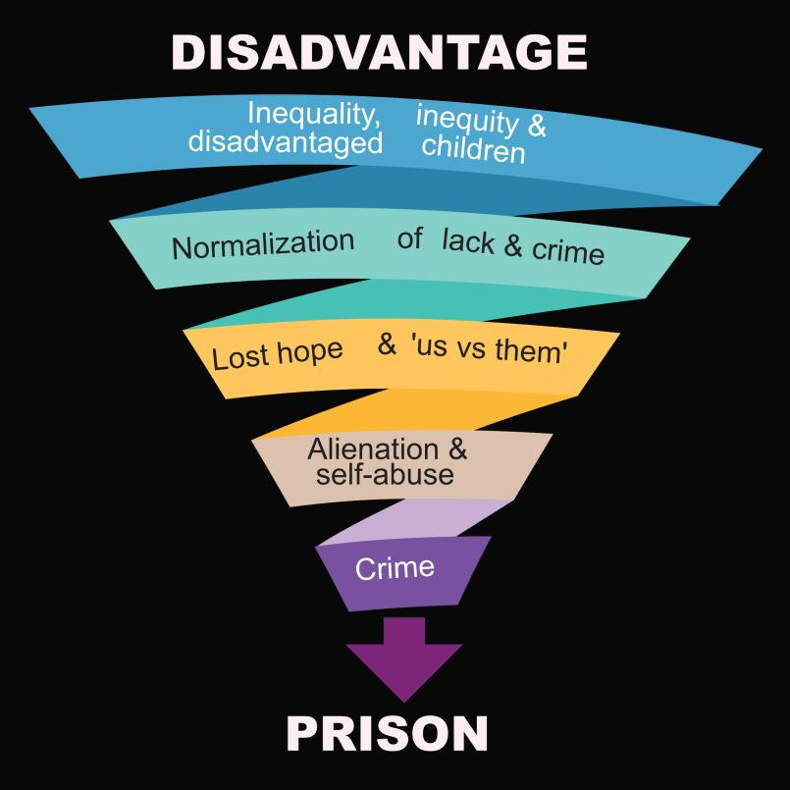
The prison spiral…
‘People in
prison are
some of the
most vulnerable people in society
and often come
from disadvantaged backgrounds’ [9,10]

Slide 6
Especially a problem for…
First Nations people:
Incarceration rate of 2,470 per 100,000 [1] (world’s highest [2])
32% of prison population [3] yet only 3.8% of Australian pop. [4]
Young First Nations people
56% of youth detention population yet only 6% of Australian pop. [5]

Slide 7
Especially a problem for…
People with disabilities:
50% prison entrants have reported disabilities (cf. 18%) [6]
Bullied & assaulted [7]
Shortage of forensic hospital beds so prison instead [8,9]
Sick and other vulnerable people… more likely to be jailed and return to prison [10]

Slide 8
Cost of incarceration
$6.1 billion per year for prisons [11,12]
Ave cost/inmate: $405/day or $148k/yr
Unsustainable: An increase of $2 billion in just 5 years! Most prisons full, so more prisoners means building more prisons

Slide 9
Indirect costs of incarceration
Negative effects on inmate’s family, community, health, housing, job, education, etc
Upon release, hard to get housing, job, transport, etc and dangers of substance misuse
Lack of a job/lower wages/lost skills mean higher costs for employment programs [10,11]

Slide 10
Prisons are ineffective
Prisons are ineffective at reforming those held [17]
Better alternatives for non-violent offenders incl. community-based orders/drug court
The worst offence of 38% of prisoners was a non-violent offence, and $2.3 billion was spent to jail them [11,12]
“Tough-on-crime” populism results in unnecessary imprisonment

Slide 11
Prisons are ineffective
Prison deepens vulnerabilities [14,15,16]
E.g. Human Rights Watch investigated 14 Australian prisons and found inmates with disabilities were subjected to regular bullying, violence and solitary confinement, with ‘devastating effects to their mental health’ [7]

Slide 12
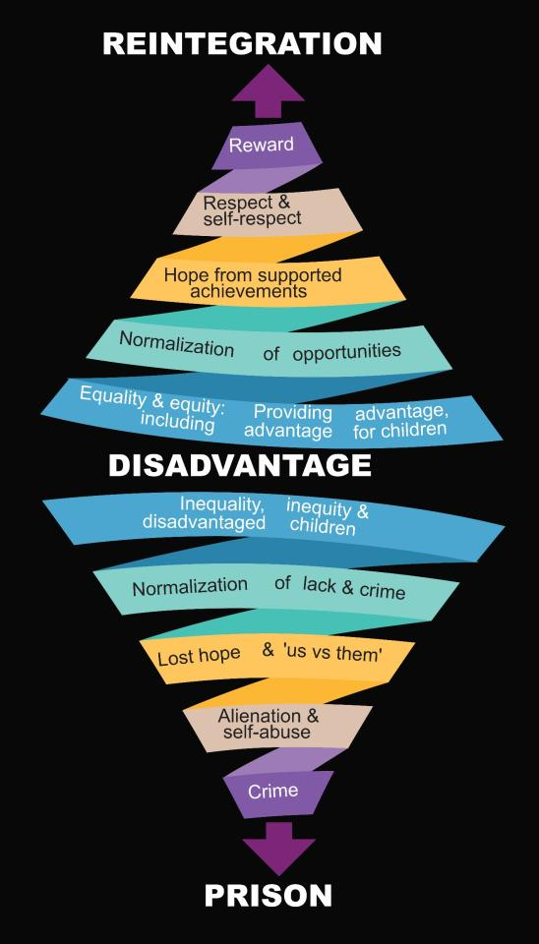
Reversing the prison spiral
Need sustained, coordinated response by all stakeholders
Aim: Eliminate disadvantage [10,13]
Can also be prison reform, restorative justice, transformative justice, community policing & abolition of police/prisons [11]

Slide 13
Justice Reinvestment
Definition:
Justice Reinvestment = redirecting funds from prisons/police to vulnerable communities with the purpose of reducing crime, the need for law enforcement & incarceration (savings are reinvested in further community-based initiatives)

Slide 14
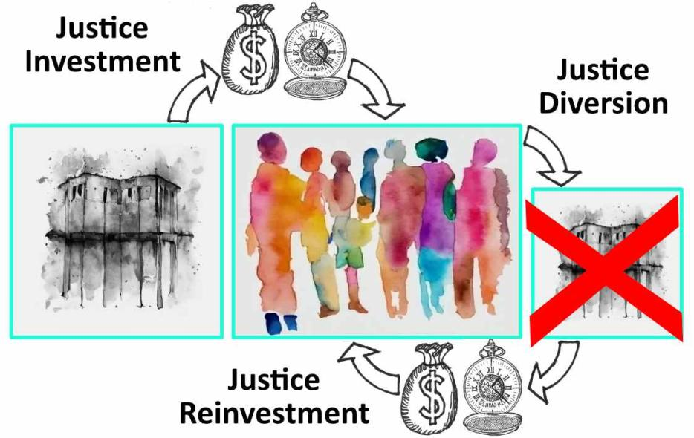
JIRAD = JI + JR + JD
JIRAD = Justice Investment, Reinvestment and/or Diversion

Slide 15
The rationale
JIRAD implementation in Australia: Limited evidence on ‘what works’ [18]
Main objective of research: To contribute to JIRAD applied economic modelling as a foundation for evidence-based JIRAD policymaking and decision-making

Slide 16
JIRAD initiatives
Each JIRAD initiative is different, with variations in:
Locality
The people involved: Stakeholders, beneficiaries, decision-makers
Investment/reinvestment amounts
Initiative purpose and design
Savings and other benefits
Investment, reinvestment and/or diversion
Investment before, during and/or after prison

Slide 17
Main thrust of research
Economic analysis of past and present JIRAD initiatives (mainly in Australia, the UK (England & Wales jurisdictions) & the USA
Tangible and intangible returns on investment/reinvestment
How effective various JIRAD initiatives/strategies are in diversion
Improved ability to predict returns

Slide 18
Other strands of research
Interviewing community members/JIRAD experts
Primary hypothesis: For optimal outcomes in the long-term, all three JIRAD activities (investment, reinvestment and diversion) will need to be implemented at the appropriate times
Secondary hypothesis: Reforms of the criminal justice system bring the greatest and most widespread benefits in the shortest possible time at the lowest possible cost, although JIRAD in poorer and more vulnerable communities is essential for medium and long-term improvement

Slide 19
Key research question 1
1. What are the tangible & intangible benefits of the JIRAD initiative?
(Focus: Cost-benefit analyses – broader & more comprehensive than ROI below)

Slide 20
Key research question 2
In given circumstances & location, which JIRAD initiative is likely to be the most effective in diversion, crime prevention, savings & other benefits?
(Focus: Comparing JIRAD strategies for effectiveness in delivering positive outcomes for vulnerable people and their communities)

Slide 21
Key research question 3
What tangible and intangible savings and other benefits (if any) may be expected following the implementation of a particular JIRAD initiative in given circumstances and a given Australian location?
(Focus: ROI for completed JIRAD initiative)

Slide 22
The 4 stages to JIRAD
‘Justice mapping’ of public spending in disadvantaged regions
Providing options to policymakers
Analysis, development and implementation of JIRAD policies
Measurement and evaluation [19]

Slide 23
Question: What’s missing?
‘Justice mapping’ of public spending in disadvantaged regions
Providing options to policymakers
Analysis, development and implementation of JIRAD policies
Measurement and evaluation
?

Slide 24
One answer…
Those most affected and their community!
The voice of those most impacted by prisons and policing
Their leadership, design & involvement

Slide 25
The upward spiral

Slide 26
Voice for the voiceless
The people most traumatised by law enforcement are the people least heard in society
For there to be change, their voices must be amplified and become pivotal

Slide 27
Who do we listen to?
Real ownership by those most impacted by law enforcement, and their community
They decide:
Who is involved
Desired outcomes
Design and process
Investment
Timing
Method of review
Who, what, when, where, why, how?

Slide 28
Example 1: Data sovereignty
The required data before, during and after each JIRAD initiative comes from the community and belongs to the community
It is not the preserve of governments and universities

Slide 29
Example 2: Who benefits?
Not just the govt & taxpayer…
To bring change, positive outcomes must primarily be for vulnerable communities

Slide 30
Example 3: Who is investing?
Not just the govt…
Mainly the community:
Donations
Time
Mental effort
Leadership & design
Trust
Risk

Slide 31
Conclusion
JIRAD holds great promise
for those harmed by the criminal justice system
for governments facing massive incarceration and law enforcement costs
Australia has been slow in implementing JIRAD, partly due to a lack of data
Expanded economic analysis and modelling of JIRAD initiatives in the Australian context can only help

Slide 32
References (1)
Australian Bureau of Statistics (Jun-quarter-2023), Corrective Services, Australia, ABS Website.
Anthony, T., 2017. Factcheck: Are first Australians the most imprisoned people on Earth? The Conversation.
Australian Bureau of Statistics (2022), Prisoners in Australia, Table 1, ABS Website.
Australian Institute of Health and Welfare (07 Sep 2023), Profile of First Nations people.
Australian Institute of Health and Welfare (13 Dec 2022), Youth detention population in Australia 2022.
Disability Royal Commission, Public Hearing 27, Transcript Day 1, p. 11.
Sharma K (2023). Australians with disabilities face pervasive abuse: Royal Commission issues highly critical report after 4-year inquiry. Human Rights Watch.

Slide 33
References (2)
Morris P (26 April 2022). The Australian mental health crisis: A system failure in need of treatment. Submission to Mental Health Select Committee by the National Association of Practising Psychiatrists.
Australian Institute of Health and Welfare (2022). Health of Prisoners.
Tanton R, et al. (2021). Dropping off the edge 2021: Persistent and multilayered disadvantage in Australia. Melbourne: Jesuit Social Services.
Productivity Commission (2021). Australia’s prison dilemma: Research paper. Australian Government
Schlicht M (2023). The cost of prisons in Australia: 2023. Institute of Public Affairs.

Slide 34
References (3)
Baldry E, et al. (2018). A future beyond the wall: Improving post-release employment outcomes for people leaving prison final report, UNSW, Sydney, doi:10.26190/5B4FD2DE5CFB4
Dowse L, Rowe S, Baldry E and Baker M (2021) Research Report: Police responses to people with disability, Submission to Royal Commission into Violence, Abuse, Neglect and Exploitation of People with Disability.
Young R (11 April 2022) Mohamad Alameddine’s bid to change bail conditions rejected, Perth Now.
Hunter F (24 February 2021) Hamzy brother arrested for alleged breach of crime prevention order, Sydney Morning Herald.

Slide 35
References (4)
Grimsrud T and Zehr H (2002) Rethinking God, justice, and treatment of offenders, in O’Connor TP and Pallone NJ (eds) (2002) Religion, the community, and the rehabilitation of criminal offenders, Haworth Press, New York.
Willis M and Kapira M (2018) Justice reinvestment in Australia: A review of the literature. Research Report 09, Australian Institute of Criminology, Canberra.
Fox C and Albertson K (2010) Could economics solve the prison crisis? Probation Journal 57(3), 263–280.

Slide 36
Thank you
Cameron Russell
aprj.com.au

